Slide 1
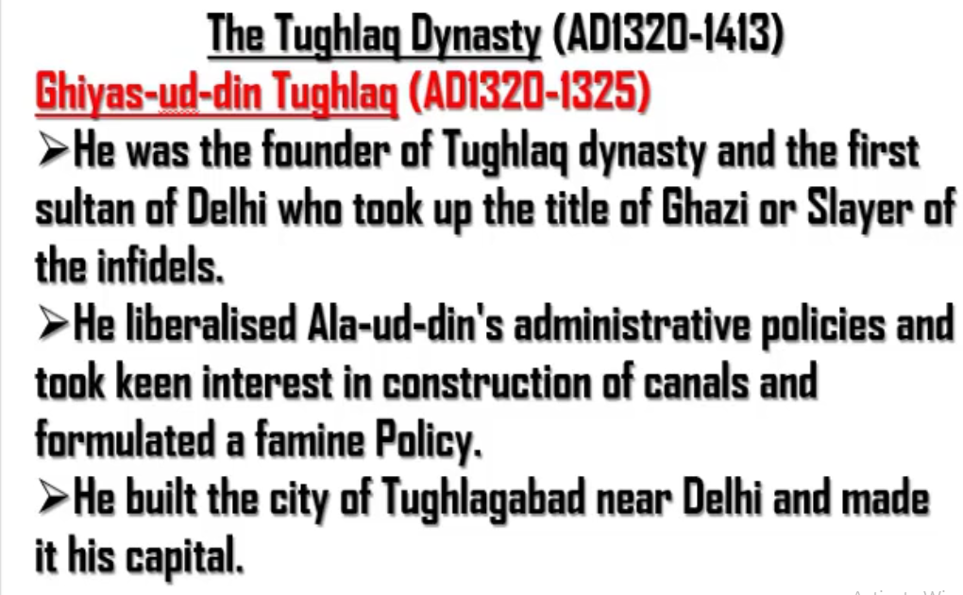
Ghazi (Slayer of infidels)
Killing of those guys who are not loyal to the king
Famine – Drought
Not only Ghiyas-ud-din, all other Tughlaqs were interested in building canals and helping people in the times of famine.

Slide 2
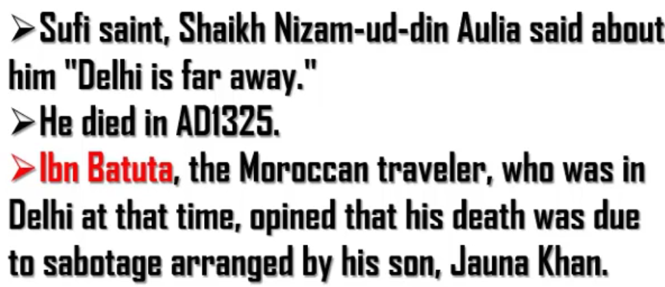
First point means that:
Delhi was far for Sufi Saint, Shaikh Nizam-ud-din Aulia
Third point means that:
Ibn Batuta was Moroccan traveler. Foreign travellers often act as historians.
According to Ibn Batuta, Ghiyas-ud-din was killed by his son Jauna Khan.
Sabotage – Plot

Slide 3
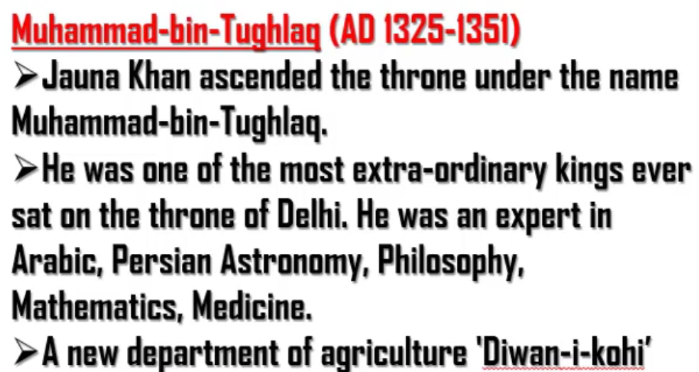
Yogapatta of Jauna Khan was Muhammad-bin-Tughlaq
A new department of agriculture ‘Diwan-i-kohi’ was established by Muhammad-bin-Tughlaq

Slide 4
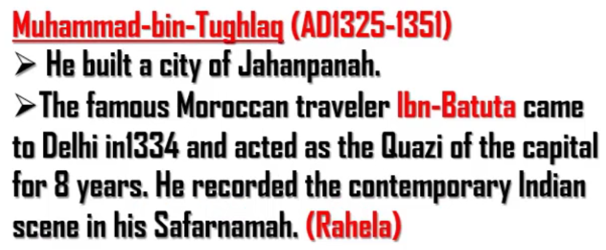
Jahanpanah
Jahan – here
Panah – world
Overall, “here is the whole world where everyone takes shelter”
Ibn Batuta was appointed as Quazi chief of the capital (Delhi) by Muhammad-Bin-Tughlaq.
Quazi – Pseudo
Quazi Chief – Pseudo Chief (He acted as chief. But the supreme chief was Muhammad-Bin-Tughlaq only)
Ibn Batuta wrote the book “Rahela”. In the book “Rahela” he had written about how Muhammad-Bin-Tughlaq killed his father Ghiyas-ud-din Tughlaq.

Slide 5
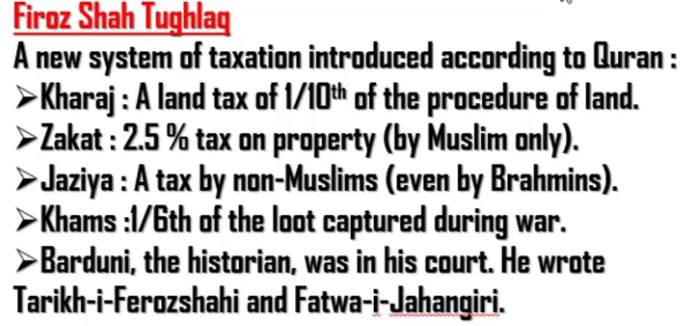

Slide 6
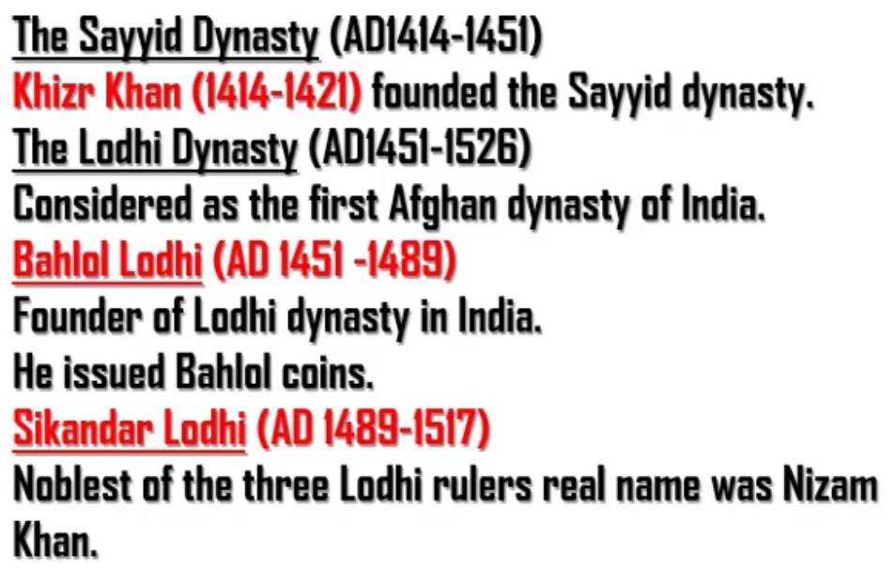

Slide 7
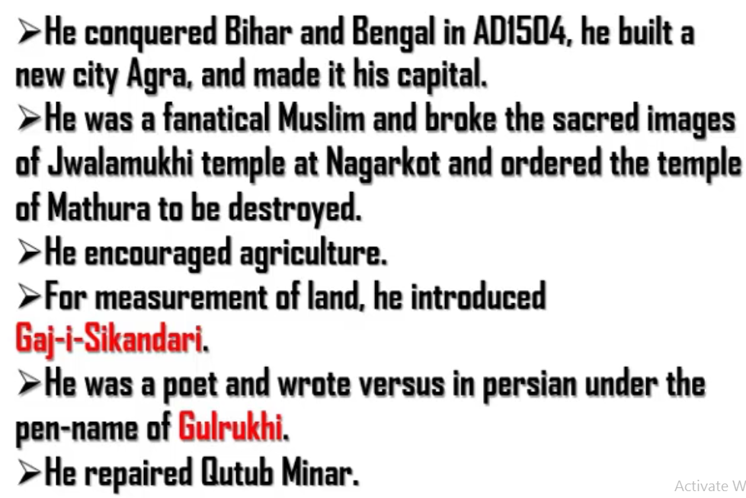
He – Sikandhar Lodhi
Fanatical – His religion is only correct. Other reilgions are not correct.
He wrote versus in Persian using the pen named Gulrukhi

Slide 8
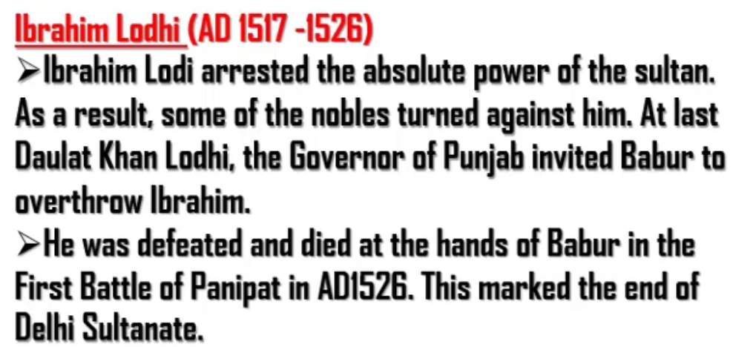
Ibrahim was very strict and powers of people were reduced. So nobles (rich and powerful) turned against him.
Also, Daulat Khan Lodhi, the governor of Punjab invited Babur to overthrow Ibrahim.
AD1526 is important

Slide 9
